Slide 1

- pocket the trains

Slide 2

What is সাইরেন?
সাইরেন
সাইরেন stands as an online platform utilizing Database Management System(DBMS), meticulously crafted for seamless navigation, browsing and efficient ticket reservation within railway systems.
Here we will briefly explain the leading features of সাইরেন.

Slide 3
Six Features
User Registration
Advanced Searching
Clarity All The Way
A user can create their own profile after verifying his/her information, and agreeing to a set of terms and conditions.
সাইরেন will track down the perfect seat for you! Our searching algorithms will assist you look for available seats, even when faced with the most stringent constraints.
No more confusing tickets. সাইরেন generates unique tickets upon confirmation for reservation, containing just the information you need!

Slide 4
Continued…
Special Discounts
Feedback
Refunding
সাইরেন offers personalized discounts just for you! Enjoy cost savings on your payment transactions, making it your budget-friendly companion.
Users can access detailed feedback on travel experience from other users, including specific insights tailored to the class of the train they are journeying in!
Sudden change of plans? সাইরেন is there for you! Within a certain time before the departure, you can cancel tickets and get your refund, easier than a piece of cake!

Slide 5
Entity-Relationship Diagram for “সাইরেন”

Slide 6
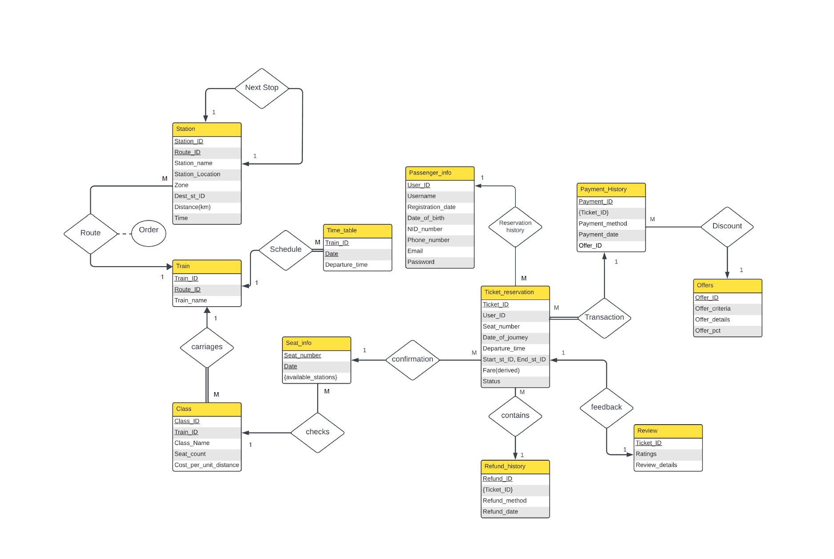

Slide 7


Meet The Team
Sheikh Iftikharun Nisa 2105069
Anika Morshed
2105068

Slide 8

Hope you have a safe journey!
Thanks!

